Slide 1

Chapter 4
Project Management

Slide 2
Class 3 2011F
All the slides are included for this chapter but we will only cover selected slides during the lecture
Discussion will also revolve around the PMBOK (Project Management Book of Knowledge) and the Project Management Institute’s approach to Project Management

Slide 3
Projects and Project Managers
Project – a [temporary] sequence of unique, complex, and connected activities having one goal or purpose and that must be completed by specific time, within budget, and according to specification.
Project manager - the person responsible for supervising a systems project from initiation to conclusion

Slide 4
Project Management and Process Management
Project management – the process of scoping, planning, staffing, organizing, directing, and controlling the development of an acceptable system at a minimum cost within a specified time frame.
Process management – the activity of documenting, managing, and continually improving the process of systems development.

Slide 5
Measures of Project Success
The resulting information system is acceptable to the customer.
The system was delivered “on time.”
The system was delivered “within budget.”
The system development process had a minimal impact on ongoing business operations.

Slide 6
Causes of Project Failure
Failure to establish upper-management commitment to the project
Lack of organization’s commitment to the methodology
Taking shortcuts through or around the methodology
Poor expectations management
Feature creep– uncontrolled addition of technical features to a system.
Scope creep – unexpected and gradual growth of requirements during an information systems project.

Slide 7
Causes of Project Failure (cont.)
Premature commitment to a fixed budget and schedule
Poor estimating techniques
Overoptimism
The mythical man-month (Brooks, 1975)
Inadequate people management skills
Failure to adapt to business change
Insufficient resources
Failure to “manage to the plan”

Slide 8
Project Manager Competencies
Business awareness
Business partner orientation
Commitment to quality
Initiative
Information gathering
Analytical thinking
Conceptual thinking
Interpersonal awareness
Organizational awareness
Anticipation of impact
Resourceful use of influence
Motivating others
Communication skills
Developing others
Monitoring and controlling
Self-confidence
Stress management
Concern for credibility
Flexibility
(Adapted from Wysocki, Beck, and Crane, Effective Project Management: How to Plan, Manage, and Deliver Projects on Time and within Budget.)

Slide 9
Project Management Functions
Scoping – setting the boundaries of the project
Planning – identifying the tasks required to complete the project
Estimating – identifying the resources required to complete the project
Scheduling – developing the plan to complete the project
Organizing – making sure members understand their roles and responsibilities
Directing – coordinating the project
Controlling – monitoring progress
Closing – assessing success and failure

Slide 10
Project Management Tools & Techniques
PERT chart – a graphical network model used to depict the interdependencies between a project’s tasks.
Gantt chart – a bar chart used to depict project tasks against a calendar.

Slide 11
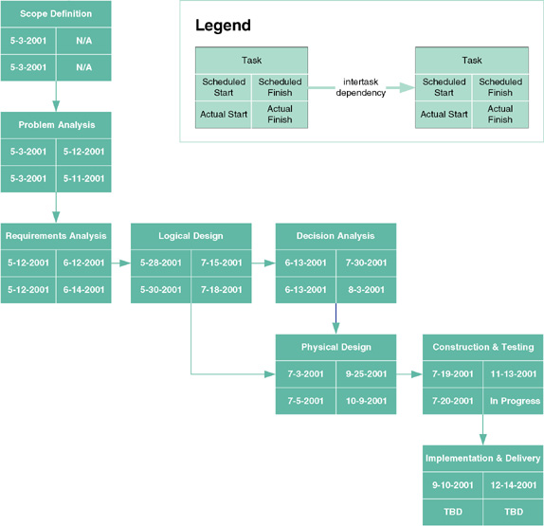
PERT Chart

Slide 12
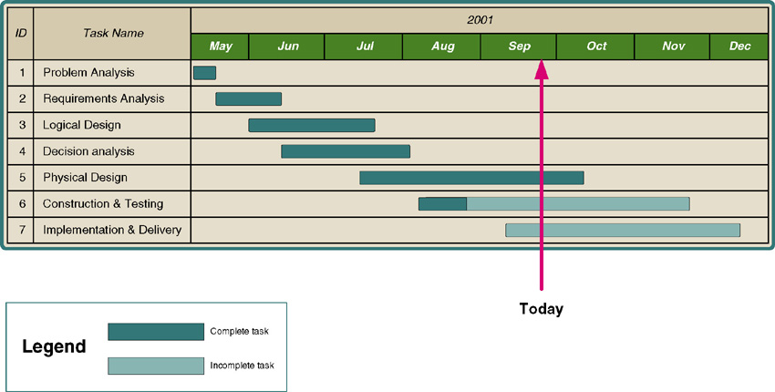
Gantt Chart

Slide 13
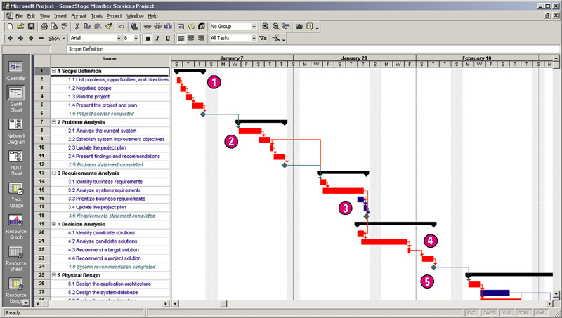
Microsoft Project Gantt Chart

Slide 14
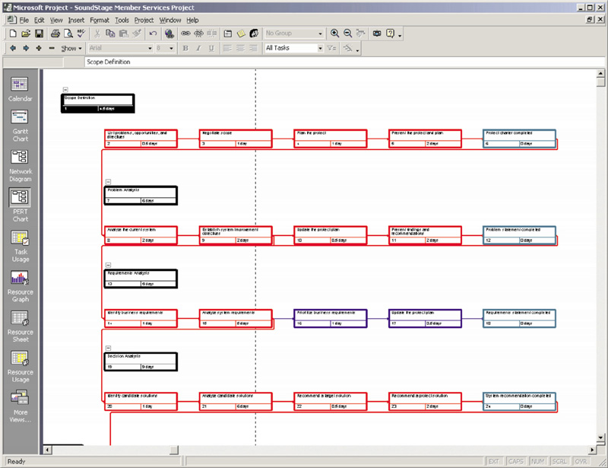
Microsoft Project PERT Chart

Slide 15
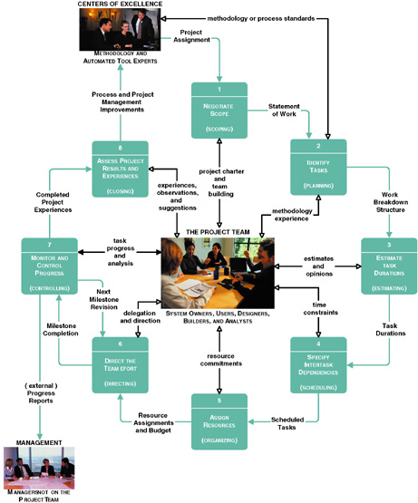
Project Management Life Cycle

Slide 16
Joint Project Planning Strategy
Joint project planning (JPP) – a strategy in which all stakeholders attend an intensive workshop aimed at reaching consensus on project decisions.

Slide 17
Activity 1 – Negotiate Scope
Scope – the boundaries of a project – the areas of a business that a project may (or may not) address. Includes answers to five basic questions:
Product
Quality
Time
Cost
Resources
Statement of work – a narrative description of the work to be performed as part of a project. Common synonyms include scope statement, project definition, project overview, and document of understanding.

Slide 18
Statement of Work
I. Purpose
II. Background
A. Problem, opportunity, or directive statement
B. History leading to project request
C. Project goal and objectives
D. Product description
III. Scope
A. Stakeholders
B. Data
C. Processes
D. Locations
IV. Project Approach
A. Route
B. Deliverables
V. Managerial Approach
A. Team building considerations
B. Manager and experience
C. Training requirements
(continued)
Notice the use of information system building blocks

Slide 19
Statement of Work (concluded)
V. Managerial Approach (continued)
D. Meeting schedules
E. Reporting methods and frequency
F. Conflict management
G. Scope management
VI. Constraints
A. Start date
B. Deadlines
C. Budget
D. Technology
VII. Ballpark Estimates
A. Schedule
B. Budget
VIII. Conditions of Satisfaction
A. Success criteria
B. Assumptions
C. Risks
IX. Appendices

Slide 20
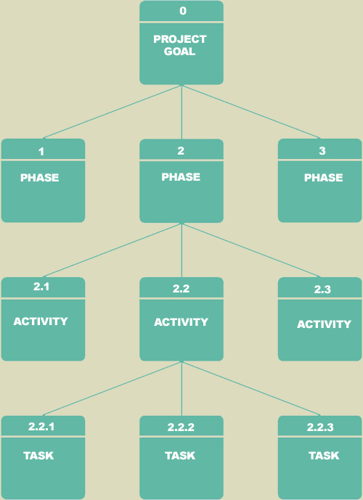
Activity 2 – Identify Tasks
Work breakdown structure (WBS) – a graphical tool used to depict the hierarchical decomposition of the project into phases, activities, and tasks.
Milestone – an event signifying the completion of a major project deliverable.

Slide 21
Activity 3 – Estimate Task Durations
Elapsed time takes into consideration:
Efficiency - no worker performs at 100% efficiency
Coffee breaks, lunch, e-mail, etc.
Estimate of 75% is common
Interruptions
Phone calls, visitors, etc.
10-50%

Slide 22
Activity 3 – Estimate Task Durations
1. Estimate the minimum amount of time it would take to perform the task – the optimistic duration (OD).
2. Estimate the maximum amount of time it would take to perform the task – the pessimistic duration (PD).
3. Estimate the expected duration (ED) that will be needed to perform the task.
4. Calculate a weighted average of the most likely duration (D) as follows:
D = (1 x OD) + (4 x ED) + (1 x PD) 6
OD
ED
PD
3.33 days = (1 x 2 days) + (4 x 3 days) + (1 x 6 days) 6

Slide 23
Activity 4 – Specify Intertask Dependencies
Finish-to-start (FS)—The finish of one task triggers the start of another task.
Start-to-start (SS)—The start of one task triggers the start of another task.
Finish-to-finish (FF)—Two tasks must finish at the same time.
Start-to-finish (SF)—The start of one task signifies the finish of another task.

Slide 24
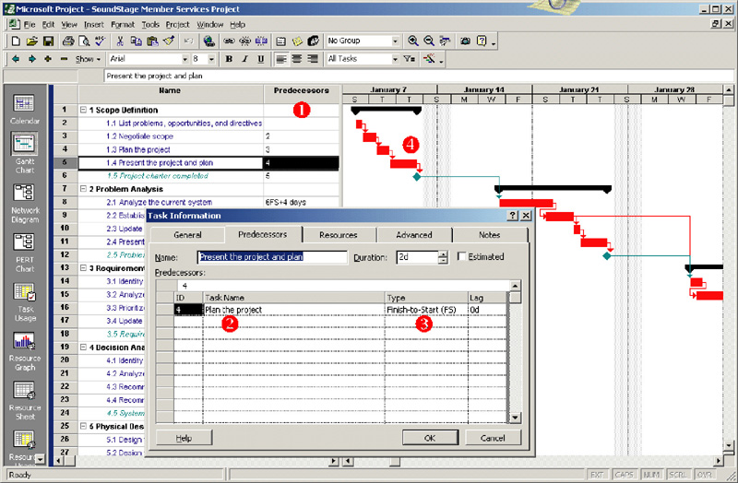
Entering Intertask Dependencies

Slide 25
Scheduling Strategies
Forward scheduling – a project scheduling approach that establishes a project start date and then schedules forward from that date.
Reverse scheduling – a project scheduling strategy that establishes a project deadline and then schedules backward from that date.

Slide 26
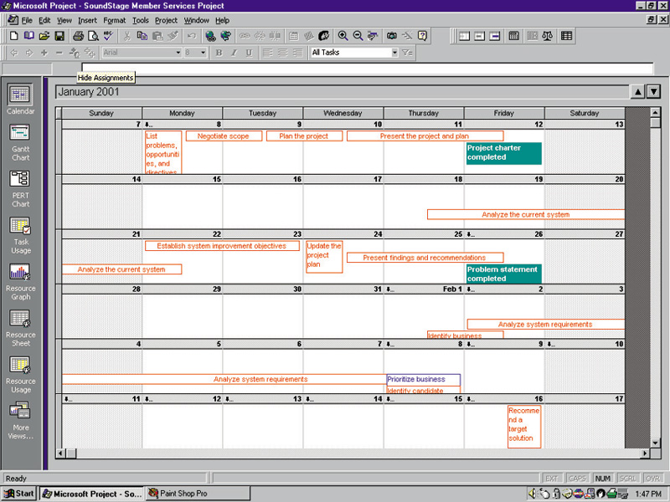
A Project Schedule in Calendar View

Slide 27
Activity 5 – Assign Resources
People – includes all system owners, users, analysts, designers, builders, external agents, and clerical help involved in the project in any way.
Services – includes services such as a quality review that may be charged on a per use basis.
Facilities and equipment – includes all rooms and technology that will be needed to complete the project.
Supplies and materials – everything from pencils, paper, notebooks to toner cartridges, and so on.
Money – includes a translation of all of the above into budgeted dollars!

Slide 28
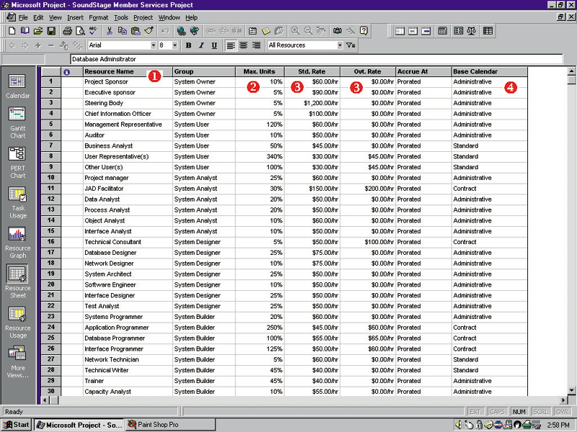
Defining Project Resources

Slide 29
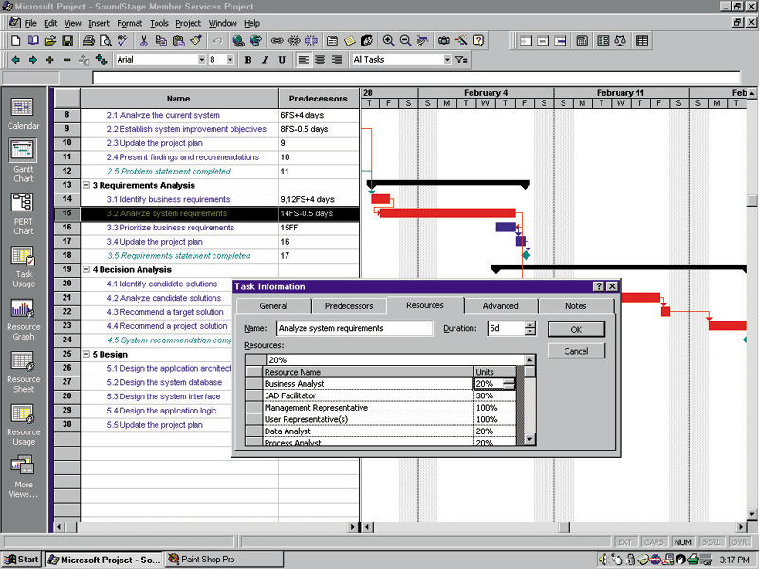
Assigning Project Resources

Slide 30
Assigning People to Tasks
Recruit talented, highly motivated people
Select the best task for each person
Promote team harmony
Plan for the future
Keep the team size small

Slide 31
Resource Leveling
Resource leveling – a strategy for correcting resource over-allocations.
Two techniques for resource leveling:
task delaying
task splitting

Slide 32
Task Splitting and Task Delaying
Critical path – the sequence of dependent tasks that determines the earliest possible completion date of the project.
Tasks on the critical path cannot be delayed without delaying the entire project. Critical tasks can only be split.
Slack time – the amount of delay that can be tolerated between the starting time and completion time of a task without causing a delay in the completion date of the entire project.
Tasks that have slack time can be delayed to achieve resource leveling

Slide 33
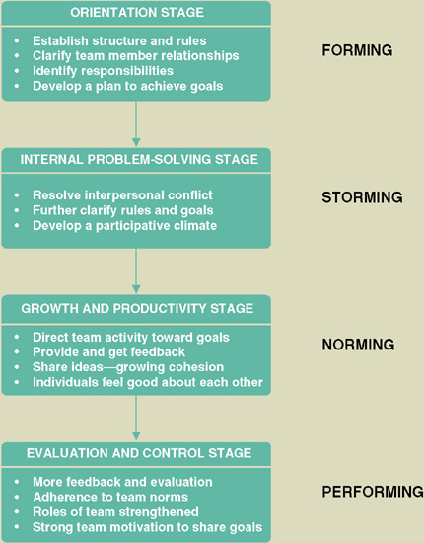
Activity 6 – Direct the Team Effort
Supervision resources
The Deadline: A Novel about Project Management
The People Side of Systems
The One Minute Manager
The One Minute Manager Meets the Monkey
Stages of Team Maturity (see figure to the right)

Slide 34
10 Hints for Project Leadership
Be Consistent.
Provide Support.
Don’t Make Promises You Can’t Keep.
Praise in Public; Criticize in Private.
Be Aware of Morale Danger Points.
Set Realistic Deadlines.
Set Perceivable Targets.
Explain and Show, Rather Than Do.
Don’t Rely on Just Status Reports.
Encourage a Good Team Spirit.

Slide 35
Activity 7 – Monitor and Control Progress
Progress reporting
Change management
Expectations management
Schedule adjustments—critical path analysis (CPA)

Slide 36
Sample Outline for Progress Report
I. Cover Page
A. Project name or identification
B. Project manager
C. Date or report
II. Summary of progress
A. Schedule analysis
B. Budget analysis
C. Scope analysis (changes that may have an impact on future progress)
D. Process analysis (problems encountered with strategy or methodology)
E. Gantt progress chart(s)
III. Activity analysis
A. Tasks completed since last report
B. Current tasks and deliverables
C. Short term future tasks and deliverables
(continued)

Slide 37
Sample Outline for a Progress Report (concluded)
IV. Previous problems and issues
A. Action item and status
B. New or revised action items
1. Recommendation
2. Assignment of responsibility
3. Deadline
V. New problems and issues
A. Problems
(actual or anticipated)
B. Issues
(actual or anticipated)
C. Possible solutions
1. Recommendation
2. Assignment of responsibility
3. Deadline
VI. Attachments
(include relevant printouts from project management software)

Slide 38
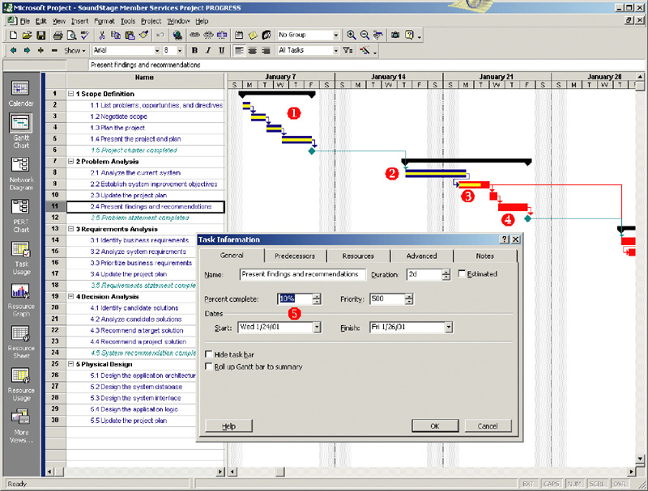
Progress Reporting on a Gantt Chart

Slide 39
Change Management
Change management – a formal strategy in which a process is established to facilitate changes that occur during a project.
Changes can be the result of various events and factors including:
An omission in defining initial scope
A misunderstanding of the initial scope
An external event such as government regulations that create new requirements
Organizational changes
Availability of better technology
Shifts in planned technology that force changes to the business organization, culture, and/or processes
Management’s desire to have the system do more
Reduced funding for project or imposition of an earlier deadline.

Slide 40
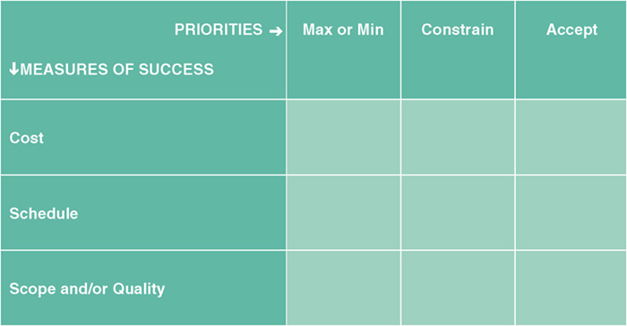
Expectations Management
Expectations management matrix – a tool used to understand the dynamics and impact of changing the parameters of a project.
The most important
The second most important
The least important
Can have only one X in each row and each column

Slide 41
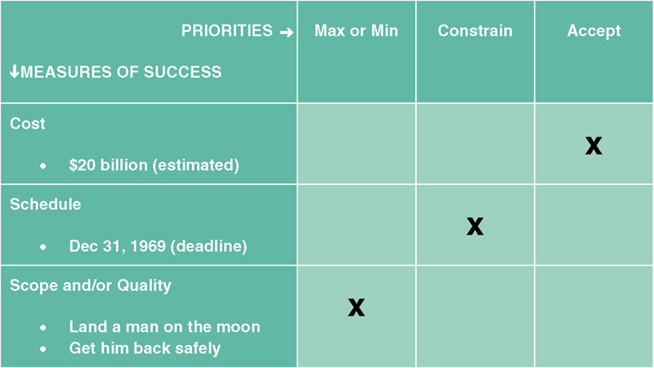
Lunar Project Expectations Management

Slide 42
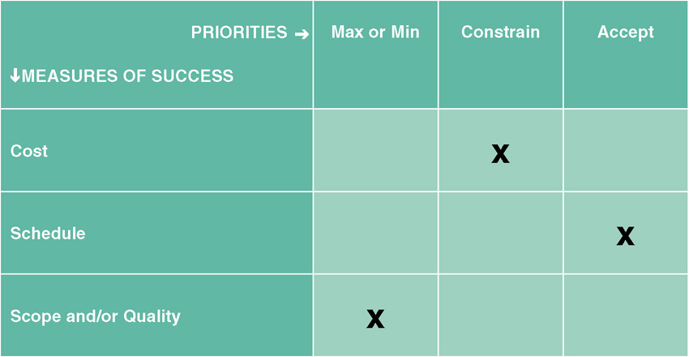
Typical, Initial Expectations for a Project

Slide 43
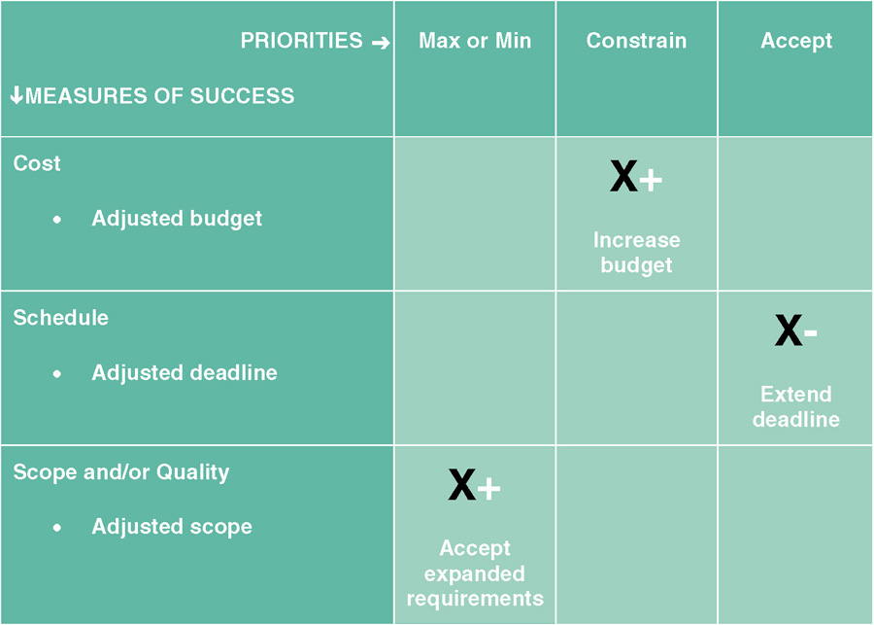
Adjusting Expectations

Slide 44
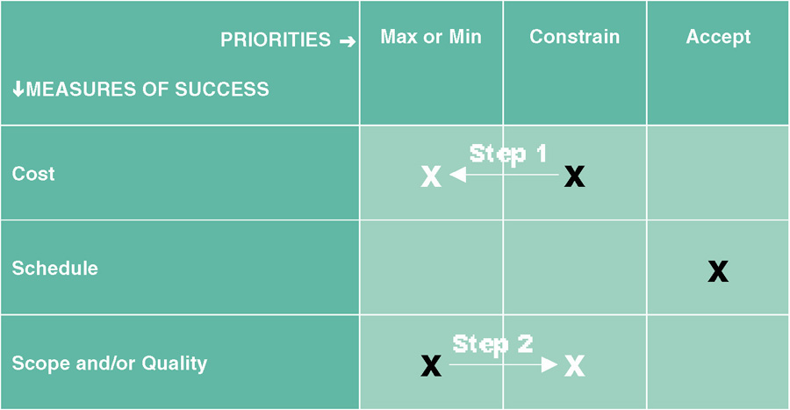
Changing Priorities

Slide 45
Schedule Adjustments - Critical Path Analysis
Using intertask dependencies, determine every possible path through the project.
For each path, sum the durations of all tasks in the path.
The path with the longest total duration is the critical path.
The critical path is the sequence of tasks with the largest sum of most likely durations. The critical path determines the earliest completion date of the project.
The slack time for any non-critical task is the amount of delay that can be tolerated between starting and completion time of a task without causing a delay in the entire project.

Slide 46
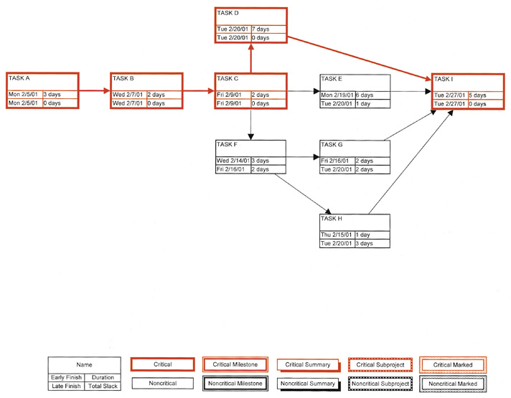
Critical Path Analysis

Slide 47
Activity 8 – Assess Project Results and Experiences
Did the final product meet or exceed user expectations?
Why or why not?
Did the project come in on schedule?
Why or why not?
Did the project come in under budget?
Why or why not?

